Slide 1
challenges of human activity recognition

Slide 2
what is human activity recognition?
Recognizing or identify activity of human can be called Human activity recognition(HAR)

Slide 3
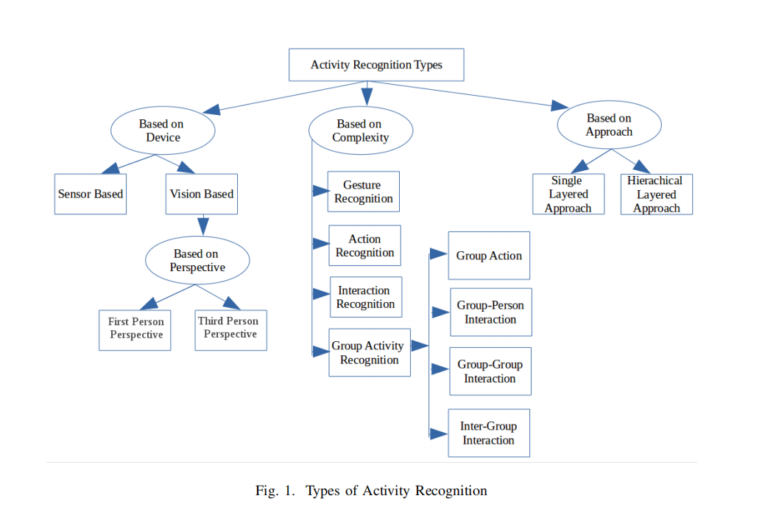
types of activity recognition

Slide 4
challenge in human activity recognition domain I
human behavior
intraclass variability
interclass similarity
illumination changes
shadow effect
partial or full occlusion
self occlusion

Slide 5
Challange in human activity recognition domain II
scaling
bootstrapping
camera jetter
camera automatic adjustments
noise frame in video
moving background objects or humans

Slide 6
human activity
Some humans can perform multiple tasks at the same time, which makes the process of recognition more difficult.
complex interaction HCI, H-H,H-O and group activity .

Slide 7
intra-class variability
A given activity, can be performed differently by different individuals
the action/activity become different result(similar or not ) by diffenent objects

Slide 8
inter-class similarity
Classes that are fundamentally different, may show similar characteristics. Example of such activity may be, skipping and running has the similar pose, which becomes challenging when pose based algorithms are used for activity recognition

Slide 9
illumination changes
There may be dynamic variations in factors such as brightness, contrast and other parameters in a video, or these parameters may be affected due to the factors such as change in environmental condition like change in weather

Slide 10
shadow effect
The shadow of the object or human may create silhouettes, which may lead to false detection and tracking of the activity.

Slide 11
Partial or full occlusions
Subject of interest whose action is to be recognized may be occluded by another object in the video. This makes it difficult to identify the activity.
Self-occlusions: One body part of the person may block the view of other part of the body (which may be significant in recognizing the activity), which typically occurs due to the viewpoint.

Slide 12
scaling
The people performing the activity, may be near or far from the device used to sense the activity

Slide 13
Bootstrapping
The background in training environment may not be the same as the one which is available where the cameras has to be actually deployed

Slide 14
camera jitter
The quality of video may be degraded due to low resolution, or poor quality of the recording device.

Slide 15
camera automatic adjustment
The modern cameras have the feature of auto-focus, white balancing and brightness adjustments, which may lead to problems since the same image may appear different in different frames.

Slide 16
noise frame in video
The pixels related to people involved in the activity may be similar to the pixels in the background, leading to difficulty in segmenting out the humans or object of interest from the background

Slide 17
Moving background objects or humans
This may lead to the wrong activity being identified, as they may be considered as the actual objects or humans involved in activity recognition.

Slide 18
the challenge from papers:

Slide 19
object segmentation
backround method
foreground method
mathods that can handle camera motion are few and view invariance is one of the major challenge for real world application.
most of method for handling view invariance have not been able to address this issue adequately . morevoer segmentation of cluttered and an occluded background is also a major challenge that has yet to be addressed.

Slide 20
in feature extraction and representation
proper features , , anthropometric variations and execution rate are resolved to a certain extent by
combining different features
still there is a space for improvement and more robust methods are desirable for handling these issues.

Slide 21
classification
activity recognition still room for improvement. more robust classifier is desirable that can work with less training samples and can handle inter and intra-class variations adequately.
imporve real-time applications.(GPU) faster.
deep neural network such as deep belief network and auto-encoders. it have great potential to overcome many HAR related challenge.
unsupervised training model should be explored for promising results.

Slide 22
summarize:
briefly , these challenge appears in object segmentation , feature extraction and representation, and calssification.

Slide 23
THANK YOU

